Slide 1
Digital Scene Matching Area Correlator(DSMAC)
By: Madhurima De
Guide: Dr. Bharath Ramakrishna (DIAT)
A Kalidasu SC E (RCI)

Slide 2
Problem Statement
Application where a drone flies in a custom 10 km x 10 km map and navigates through predefined trajectory on a simulation platform.
As the images acquired during mission planning is in RGB spectrum but the camera attached to the drone will capture Infrared spectrum images during flight, hence we need to correlate between images in visible spectrum and thermal spectrum.

Slide 3
What is DSMAC?
It is an autonomous navigation system/ guidance system used in missiles and drones.
It uses digital image processing to compare and match real time image of the terrain with pre-stored reference images, compensating for errors in other navigation systems like inertial guidance.
It allows the drone to determine it’s position and adjust the trajectory.

Slide 4
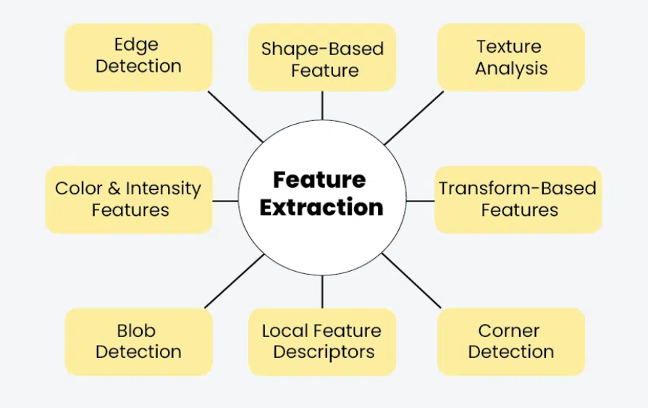
Working of a DSMAC
1. Pre-loaded map: A DSMAC system requires a detailed map of the target area, often created from satellite or areal imagery and stored in the drone’s memory.
2. Real-time image acquisition: The drone’s camera captures images of the terrain below as it flies.
3. Feature extraction and matching: The system identifies and extracts distinctive features and structures from both the captured images and pre loaded map.

Slide 5
Working of a DSMAC
4. Correlation: The system that compares the extracted features from the live images with those from the map, calculating a “correlation score” to determine the best match.
5. Position Correlation: Based on correlation results, the drone can determine it’s precise location and make corrections to it’s flight path, potentially even compensating for GPS errors and jamming.

Slide 6
How Area Correlation Works?
Area-Based Matching: This method finds matching areas in two images by comparing their brightness or color values.
The "Sliding Window" Approach:
1. A small "template" image is systematically moved, or "slid," across every possible position
within a larger “target” image.
2. At each position, a mathematical measure of similarity is calculated between the template
and the overlapping part of the target image.
3. The position with the highest similarity score (or lowest dissimilarity score) is identified as
the best match.
When it's Used: Particularly useful when images lack very distinct features, and the important information is in subtle intensity patterns.

Slide 7
Key Traditional Methods
These methods quantify how "similar" two image regions are.
Metric | Principle | Output Range | Perfect Match Value | Sensitivity to Illumination/Noise | Computational Cost
SAD | Sum of absolute pixel differences | [0, ∞) | 0 (minimum) | High | Low
SSD | Sum of squared pixel differences | [0, ∞) | 0 (minimum) | High | Medium
NCC | Normalized cross-correlation | [-1, +1] | +1 (maximum) | Low | High

Slide 8
Newer approaches
Feature-Based Matching:
Idea: Instead of comparing raw pixel areas, this approach extracts and matches distinctive "key points" (like corners, edges) and their unique "descriptors".
Algorithms:
SIFT (Scale-Invariant Feature Transform): A pioneering algorithm known for its robustness to scale, rotation, translation, illumination changes, and blur.
SURF (Speeded-Up Robust Features): Similar to SIFT but generally faster, also robust to various transformations.
ORB (Oriented FAST and Rotated BRIEF): Free, fast, and efficient alternative to SIFT/SURF.
Combines:
1. FAST (Features from Accelerated Segment Test) for key point detection.
2. BRIEF (Binary Robust Independent Elementary Features) for descriptors.
3. Adds rotation invariance & noise resistance.

Slide 9
Literature Survey
Evolution of DSMAC: Early Block II systems used analog preprocessing and “voting” methods, while Block IIA introduced all-digital processing, inertial-aided shifting, and correlation addition for higher reliability.
Reference Map Preparation: Geodetic control, warping, resolution reduction, filtering, and binarization were applied to generate stable, low-resolution binary reference maps.
In-flight Processing: Sensed frames were filtered, resolution-reduced, and binarized to produce correlation surfaces, with short exposures minimizing motion blur.
Forecast Modeling: Analytical models (Mostafavi & Smith, Criss, Jordan) predicted correlation loss due to geometry, noise, and perspective; tools like Analyst and Compare supported shadow suppression, stability checks, and map maintenance.
Limitations & Future Scope: Forecast models often underestimated geometric/perspective losses, pointing to the need for refined modeling and adaptive algorithms for challenging conditions.
Reference: G. B. Irani and J. P. Christ, “Image Processing for Tomahawk Scene Matching,” Johns Hopkins APL Technical Digest, vol. 15, no. 2, pp. 141–155, Apr.–Jun. 1994.

Slide 10
Progress
Downloaded datasets.
Pre-processed the data and applied normalization.
Studied traditional as well as newer area correlator methods.
Identifying and studying new algorithms that can be applied to correlate between RGB spectrum and Infrared spectrum images.

Slide 11
Thank You

